Slide 1


Slide 2
How to build Enterprise BI in agile manner
Marcin Szeliga
Sławomir Malinowski

Slide 3
Agenda
Saur Group
Project framework
Process and organization
Architecture
Development methodology
ETL
Data quality
Data access – security
Data mining
Results achieved

Slide 4



Marcin Szeliga
Data Philosopher
20 years of experience with SQL Server
Data Platform MVP & MCT
MCSE: Data Platform & Business Intelligence
MCSD: Azure Solutions Architect & Microsoft .NET
marcin@sqlexpert.pl

Slide 5

Saur Group
Third water and waste water company in France from turnover standpoint
Water and waste water
Waste management
Engineering
Infrastructure services
Leisure
Head-office in Guyancourt near Paris, +12000 employees
Present in international market: Poland, Spain, Kingdom of Saudi Arabia, Scotland, Armenia
€1,7 bln of revenue in 2014
www.saur.com

Slide 6























Project Business Intelligence
Smart Technology
Phoenix Program – digital transformation
20 business and IT projects

Slide 7
Project framework

Slide 8
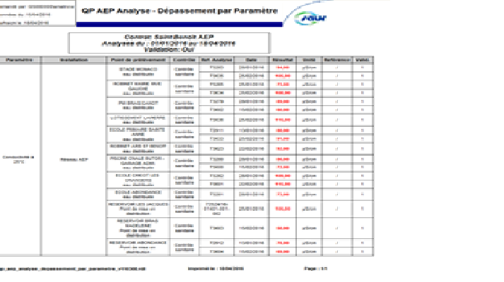
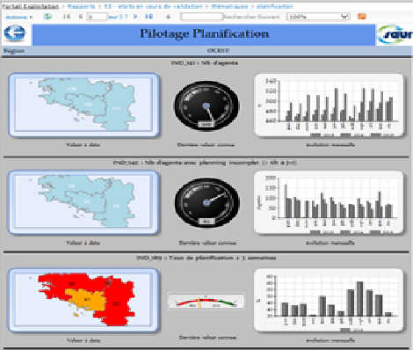
Former environment
Data marts in RDBMS (MS SQL Server 2008 R2 Standard)
Conforming for some dimensions (organization)
More than 2 000 SSRS printouts published
Printouts executed during night treatment and distributed within organization
Long duration of data analysis
SSAS in multidimensional mode (3 cubes)
SSIS almost not used, integration based on stored procedures
SSRS developers spread in the organization
Business rules hard-coded in IT solutions

Slide 9
BI project’s objectives and ambitions
Common environment for enterprise data analysis
Analyse data across business units
Data quality processes managed by business
Self-service BI
Prediction models
Agility and results of each iteration controlled by business
Only MS SQL Server 2014 components

Slide 10
Hub-and-Spoke architecture
Ralph Kimball (think big, start small)
Bottom-top design (no master plan)
Datamarts evolution to datawarehouse
Quick results
Risk of redoing things
Sources
of data
Back room
Front room
ETL1
Stage
Normalized tables (4NF)
Atomic data
ETL2
DWH OLTP
Star model
Atomic data
Organized by business process
Uses conformed dimensions
User queryable
OLAP
feed
OLAP
Tabular model
Multidimensional model
Atomic and summary data
BI
Presentation area

Slide 11
Execute numerous steps in BI project
Embedded BI
Advanced analytics
Enterprise BI
Wide and simple data models
Data profiling
KPI’s, dashboards, standard reports
Information distribution
plan
Data quality improvement
Data mining
algorithms
Complex calculations
Data synchronizationMDM
Each step is a deliverable for business!
Gives time for organization to reach certain level of maturity and verify each step of project

Slide 12
PRocCesS and organization

Slide 13
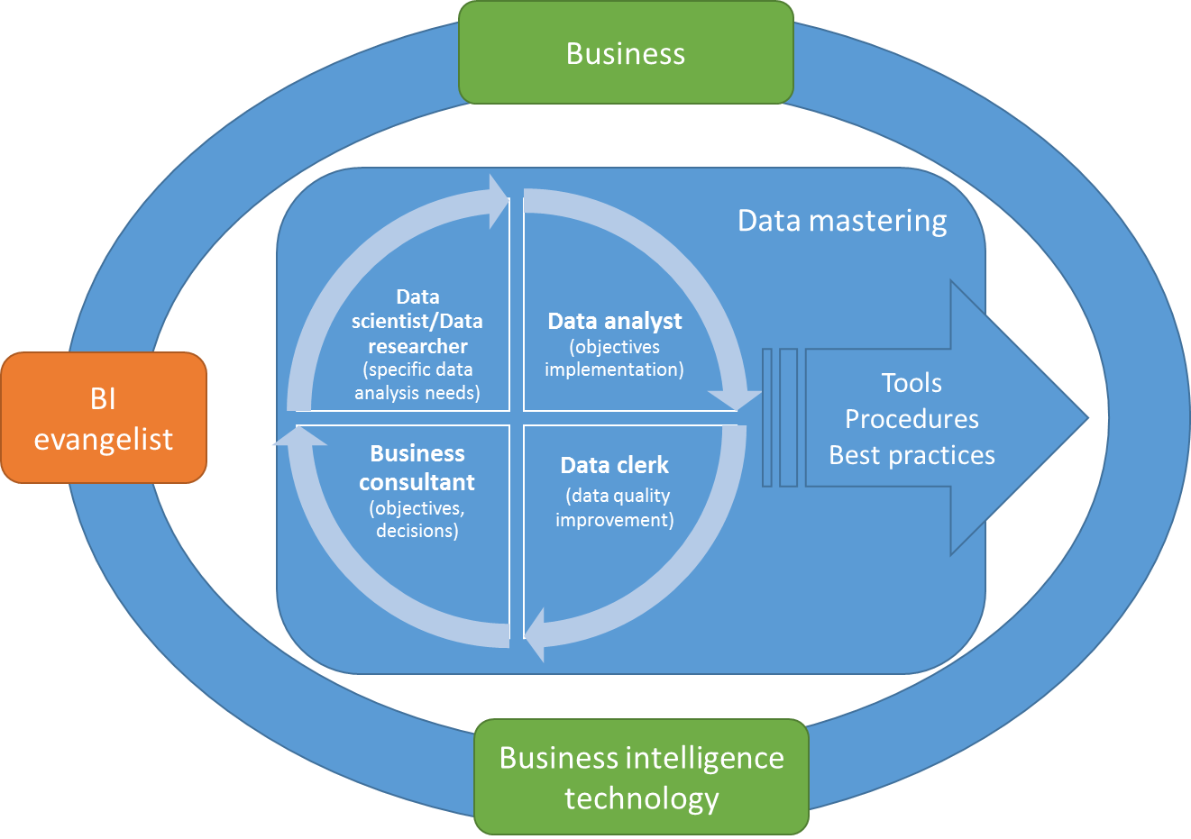
How to bind business and BI technology?
Network of people
Organisation is vital part of BI project
It assures business interest in building, supporting and proper consumption of BI services
It turns data value into business strategy

Slide 14

Working lifecycle for business consultants, data analysts, data clerks and BI team
Need of business information
(business consultant, data analyst)
Analytical data model research
Model relevancy assessment
(data analyst)
Data quality assessment
(data analyst, data clerk)
Model and data quality improvement plan
(business consultant, data analyst, data clerk, BI team)
Data quality improvement process (data clerk)
Informational output analysis
(business consultant, data analyst, data clerk)
Presentation layer planning and execution (business consultant, data analyst, BI team)

Slide 15
architecture

Slide 16




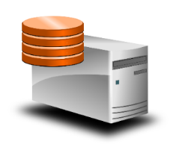






Physical architecture
Two MS SQL Server 2014 clusters (2xHP DL580, 2xDL380), Enterprise and BI Edition
Dedicated SAN EMC (20TB), FC 16Gbps
Azure
Office 365
Power BI
2 CLUSTERS HA
Stage, DWH, SSAS
Node1
Node2
Node1
Node2
MS SharePoint Farm
Stage, DWH, SSIS, SSAS Tabular
DQS, MDS, SSAS
Multidimensional
MS SharePoint Foundation
SSRS, Datazen front-end
Datazen Enterprise
datasets holder+
SMS SQL Server 2014 SSRS
SAN storage
MS SharePoint Enterprise
SSRS, Datazen front-end
MS SharePoint
database holder

Slide 17
Logical architecture
End-user
WEB interface
End-user WEB &
Native apps
End-user
WEB & Native apps
End-user
WEB interface
Data quality assessment
ETL
MS SharePoint
Found/Std/Ent
DataZen Ent. server
Power BI
Desktop
MS SSRS
Data profiling
MS Excel
MDS
DQS
OLAP DWH
Tabular
Multidimensional
Enterprise Gateway
ETL
Azure
Power BI in O365
data sources
data sources
data sources
data sources
OLTP staging
OLPT DWH

Slide 18
Visualization – Power BI
www.powerbi.com

Slide 19
Development Environment

Slide 20
Project’s time factors

Slide 21
Boosting ETL development
Mist
TFS
(source code storage and versioning)
Coding support, metadata
(controlled metadata objects,
metadata validators)
Automatic documentation’s
generation
BIML framework (SSIS XML generation)
MDS
(metadata storage and versioning)
Unlimited & dynamic definition of metadata
metadata extension
C# scripts
objects iteration
library components additional specific logic
Automatic ETL packages generation
Excel
client
MS SQL Integration Services packages
SSDT
SSIS DB

Slide 22
Development methodology
Data profiling
SSIS package prototyping
Prototyped package analysis
Strong repeatable rules and objects iteration – implementation in C#
Weak repeatable rules – implementation in metadata (relevant metadata model)
Components conceptualization
Basic and aggregated components’ library
Final implementation in Mist
Basic and aggregated components’ library update
Implementation of data flow for specific requirements
Documentation update

Slide 23
ETL

Slide 24
ETL – data flow
Extract data from
data sources
OLAP feed
ETL1
Staging
OLTP DWH
OLAP DWH
Data source
Cubes/Tabular
Data source views
Data source views
Staging tables
Data warehouse
Dimensions
Fact tables
Views for dimensions
Views for fact tables
Incremental data of fact tables
Aggregates/KPI calculation
Data source
tables
CDC
ETL2
ETL2
ETL3
Data and model
transformation
Data merge
Conforming
Aggregates
Snapshot fact tables
Data quality

Slide 25
Some important facts
Stage
Data compressed on page level
Data is partitioned by region or other factors
Automatic data compression/decompression
Audit area covers: performance, indexes defragmentation, data model analysis, ETL performance
CDC for differential load for fact tables
Full load of dimensions
Data warehouse
Compression (Dimensions – page, Fact tables – columnstore)
Star model
SCD0-SCD2
Audit area covers: performance, indexes defragmentation, data model analysis, ETL performance
Tabular model
Fact tables dynamically partitioned by year
Full load of dimensions
Differential load of fact tables (last partition)
Full load of cubes during weekends
Snowflake models
Row-based security

Slide 26
How does it work? First you need to export data….. ETL1
ETL1 - extracts fast and proper way needed data from data source and place it in staging with almost no transformation
Input metadata for connection to data source
Define export schema (e.g. BIExport) views to extract the data
Input metadata if you want to rename destination tables and columns (optional)
Create separate Mist project for each data source
Standard BI extraction code supports:
DDL ETL package to create destination objects
Full and incremental load
High-water-mark processor
Lineage processor
Event and error logging with execution audit area
Deletion of data reported by data source
Business key detection
Synthetic primary key generation (usually need adjustment)
Automatic detection of changes for joined objects (cascade update on related objects)

Slide 27
ETL1 in pictures
3
1
Initial metadata
MDS
Metadata reading
Mist project
Reads views’ metadata
Creates destination objects
4
Generates full ETL package
Generates incr. ETL package
5
Data source
Stage
2
6
Export schema
views
Destination objects
Full load package
7
Incremental load package

Slide 28
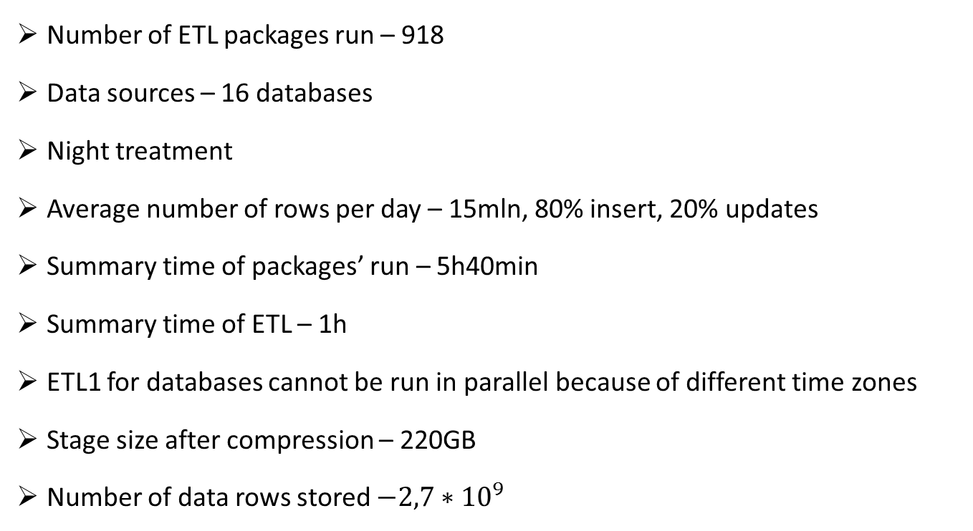
ETL1 (CRM)
Number of ETL packages run – 918
Data sources – 16 databases
Night treatment
Average number of rows per day – 15mln, 80% insert, 20% updates
Summary time of packages’ run – 5h40min
Summary time of ETL – 1h
ETL1 for databases cannot be run in parallel because of different time zones
Stage size after compression – 220GB
Number of data rows stored $−{2,7∗10}^{9}$

Slide 29
Second you need to transform your data…
ETL2 – transforming from highly normalized data models into star model by moving data from stage to data warehouse, measuring and improving data quality
Re-model data using views in staging thus will create dimensions and facts in data warehouse
Input extended properties for additional transformations
Input extended properties for data quality processes
One unique ETL2 supports:
Dimension and fact table creation in DWH
Full load and incremental load
High-water-mark processor
Lineage processor
SCD0-SCD2 support for dimensions’ attributes
Data quality scenarios for dimensions
Update of fact table
Data quality measurement and audit area
Normalization of fact tables by creating junk dimensions
Data compression/decompression and partitioning
Synthetic key’s generation
Event and error logging with execution audit area

Slide 30
ETL2 in pictures
Mist project
Reads views’ metadata
Creates destination objects
2
Generates full ETL package
Generates incr. ETL package
3
Stage
Data warehouse
1
4
Dimension and fact tables + extended properties
Star model
Full load package
5
Incremental load package
DQS+MDS

Slide 31
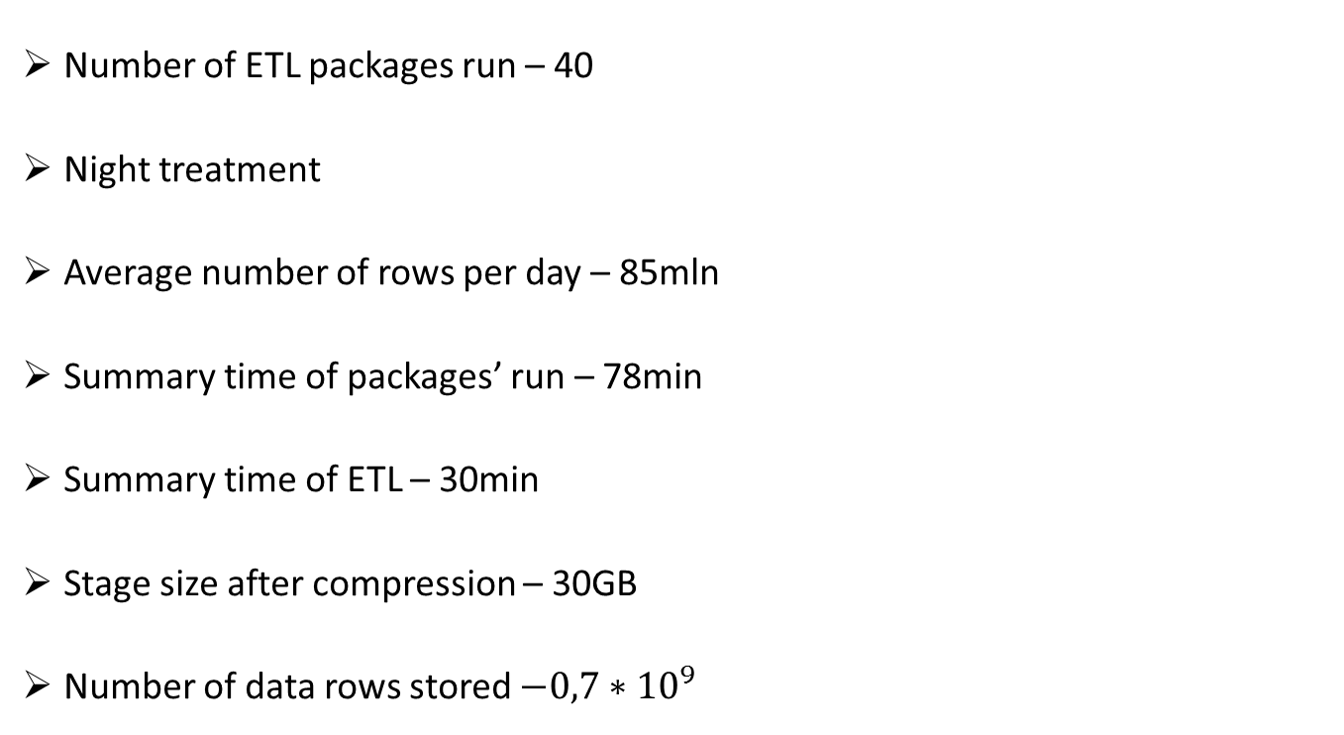
ETL2 (CRM)
Number of ETL packages run – 40
Night treatment
Average number of rows per day – 85mln
Summary time of packages’ run – 78min
Summary time of ETL – 30min
Stage size after compression – 30GB
Number of data rows stored $−{0,7∗10}^{9}$

Slide 32
Data quality

Slide 33
Data quality issues - where they are?
Data understanding
Actions
Needs
Data layer
Process data in ETL
Transform data model
Improve business data quality
ETL business rules
(data model stability)
Data profiling
(on technical objects)
Data cleansing
Per-row (row-by-row) business rules
Data matching
(conforming process)
Data quality measurement
Data sets business rules
Data profiling
(on entire business objects)
Critical data understanding for data movement and transformation
Understanding technical representation of data
Understanding of data quality aspects by business
Understanding business representation of data and influence of data quality
Relational (OLTP)
Technical data representation
Star model (OLAP)
Business data presentation
Staging (back-room)
Data warehouse (front-room)

Slide 34
Data quality issues - where they are?
ETL
Data extraction and movement
Modelling of business data
Technical representation (back room)
Data model’s transformation
Value of data
Completeness
Uniqueness
Integrity
Relevancy

Slide 35
Data quality scenarios for dimension Deriving new dimension
Data is not included in any company’s data sources. Data is stored in MDS and accessed by data clerks via Excel
Experts’ data
Data or vocabularies hard-coded in applications
Common vocabularies
External data (www, services, social media)
Data can be controlled by business rules
External data
MDS
Data warehouse
Staging
External data
Business validation rules
Dimension
Dimension table
Rows after assessment
Data quality
assessment area
Validation results

Slide 36
Data quality scenarios for dimension Assessment of existing dimension
Data quality supervision by data clerk
Data is moved from Stage to MDS and accessed by data clerks via Excel
Data can be controlled by business rules
Data can also be changed by business rules
MDS
Staging
ETL2 Unknown rows
Dimension
Business validation rules
ETL2 known rows
Data warehouse
Dimension
view
Dimension table
Data quality
assessment area
Data validation results

Slide 37
Data quality scenarios for dimension Processing of single attribute by DQS’s simple domain
Data quality processed by data clerk
Manual load of template
Staging
MDS
DQS
Dimension’s attributes
template
Dimension
and cleansing results
Stage source table
Entity
Pre or post-ETL2
Knowledge flow
View
Business validation rules
& cleansing results
Derived table from MDS
Incorrect/Correct/Corrected attribute
Data quality
assessment area
Data cleansing results

Slide 38
Data quality - architecture
Initial load of KB by DBA’s
DQS enrichment
Corrected data
Knowledge discovery
MDS screen to alter or validate data
Output/input to
Validate or alter data
Initial load of
domains’ attributes
MDS entities
Data quality assessment
MDS
Entities’
rules
Data clerk
DQS KBs
Locked down
Rules to log and find
erroneous data
DQ KB domains’
attributes and rules
All rows
Corrected data
DWH database
SSIS DQS KB
Differential data assessed by DQS
SSIS
DWH load
All rows
Corrections Inferred members
Data assessed
and improved
by DQ KB
All rows
Data quality events logging
Log output for
business end-users
data or metadata
storage
New data
Data flow
Knowledge flow
End-user
input/output
data clerk
ETL

Slide 39
Data access - security

Slide 40



Data access security - concept
What are dimensions to define data access in BI?
What are fact tables to be protected?
‘Security’ dimensions
Protected
dimensions and fact tables
implication
connected
What are public, private, sensitive or confidential information in dimensions and fact tables?
Division of dimension and fact tables into 3 categories: public, private and confidential
Securing private and confidential data with different models and security system
implication
External clients?
implication
The same security model
should be used?

Slide 41
Data access security – translation zone
Access in data source
Translation zone
Access in data warehouse
Exposition to external division (security team, business, production, …)
RBAC
MDS
Access translation - Linking groups or users
into
sets of dimensions’ keys
which play a role of data access security
Data warehouse
Public
Private !
Confidential !!!
Profiles, users
Dimensions’ keys
end-user
AD security groups
Groups, users
Business application
Users, (profiles)

Slide 42

Data access security - granularity
Page/report based security
MS SharePoint
Foundation/ Standard/
Datazen, Power BI
High grain
security definition
This data access shouldn’t select sensitive or confidential data
T-sql
Direct query
Fine grain
security definition
Data warehouse
SSAS
tabular
Role-based security
Row-based security
Specific technics should be used during analytical model design:
Specific DAX formulas
Splitting dimensions and their attributes into confidence categories
Perspectives

Slide 43
Data mining

Slide 44
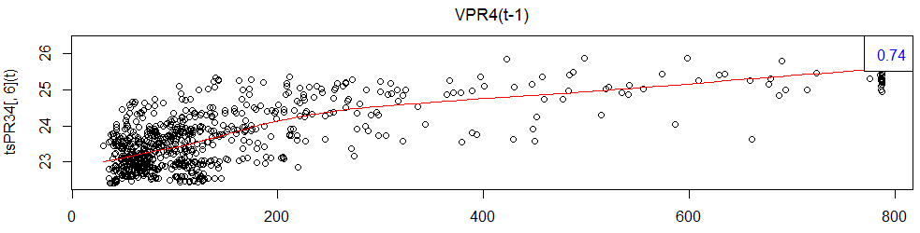
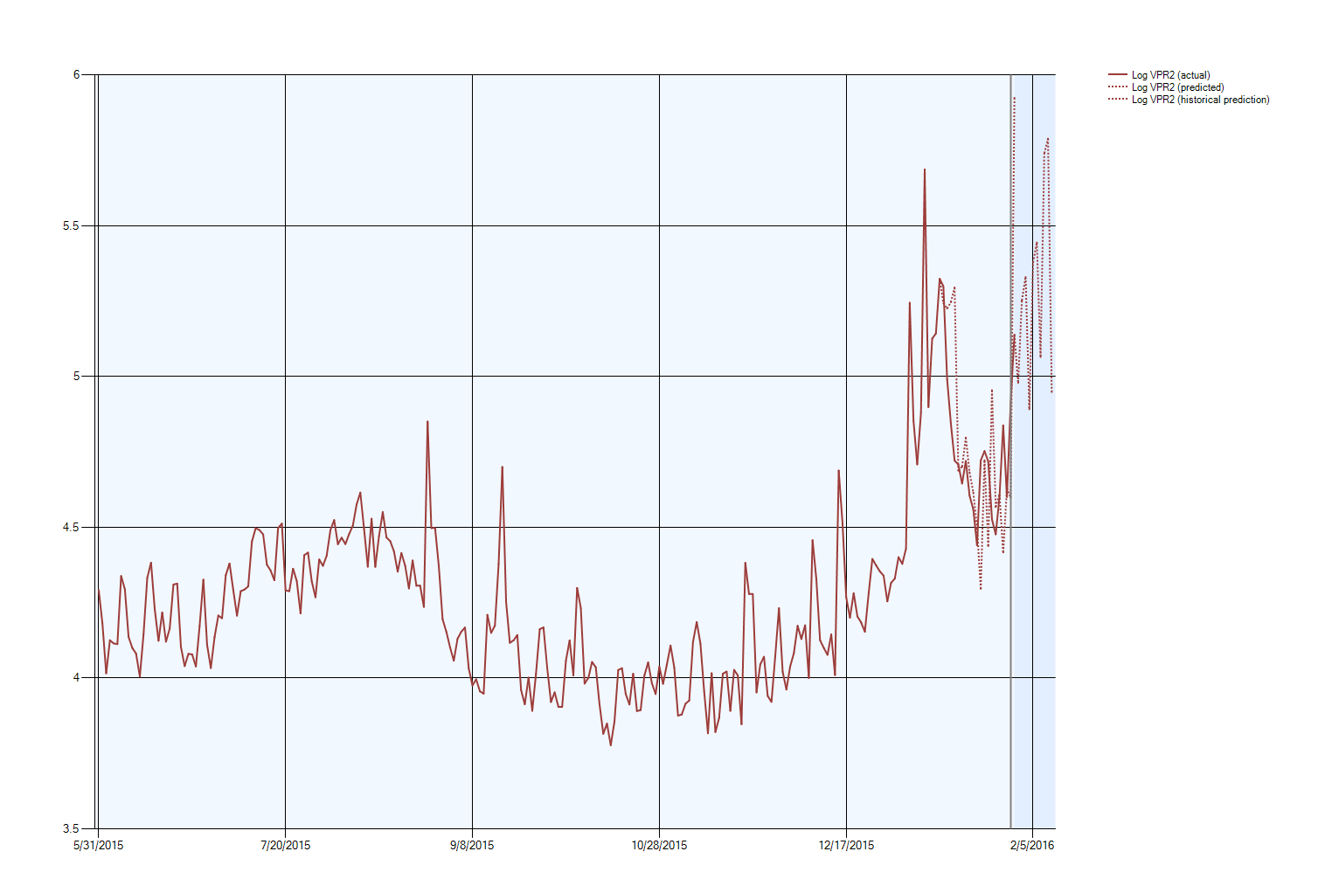
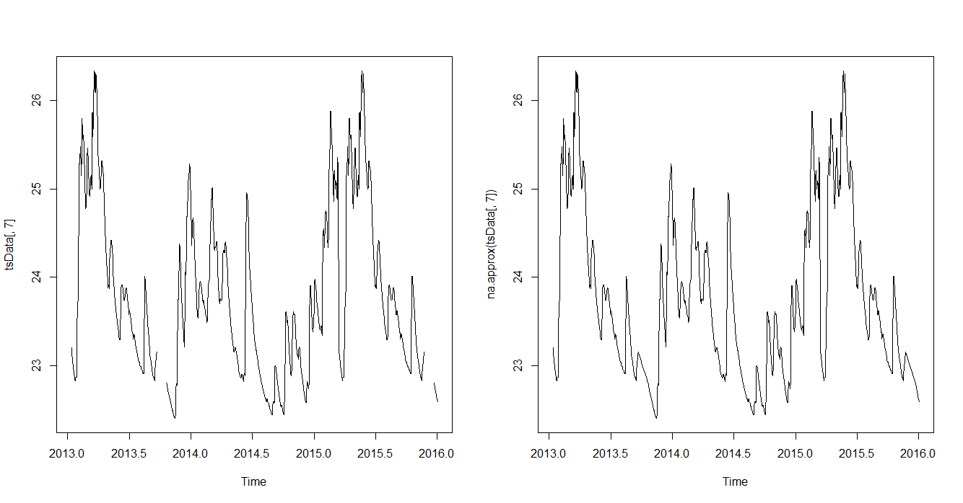
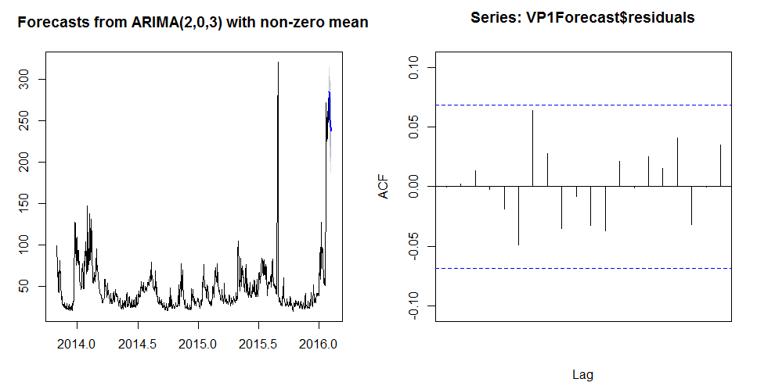
How to know more about water volumes in networks ?
Goals - optimize costs and switch to proactive management by:
Better understanding of impact from rain and underground water level
Better capacity to predict volumes to manage in future
Localize water leakage
Categorize sectors
R for:
Data exploration
Replacing missing values
Tuning ML algorithms
SSAS ML for:
Time series predictions
Clustering

Slide 45
Results achieved

Slide 46
Major achievements
BI environment is an open platform for data de-normalization dedicated for data analysis
BI team members are in charge of data modelling, inputting metadata and extended properties only
Automatic ETL generation – short cycles in project, many iterations
Data quality - open interfaces for business (data clerk, data analyst, data researcher)
Ability to deliver self-service BI for end-users

Slide 47
Some difficulties
Data source
Data source’s model not stable?
Data source do not provide high-water-mark?
Data source never reports deleted rows?
Stage
Performance tuning
Propagation of data changes in model
Data quality

Slide 48
Contacts
marcin@sqlexpert.pl
slawomir.malinowski@saur.com
Merci!
Dziękujemy!
Thank you!

